Slide 1
Marrying Workflow and Lifeflow:
A Patient and Clinician Story
Reminder hit *6 to unmute
Then re-mute after done by
Hitting *6 or your mute button
Special Edition of Hot Topics
December 16, 2016
Michelle Troseth, CPPO
Special Guest: Danny van Leeuwen
Notes:
Dial into webex and call at 8:40am
Meet Bonnie Karfeld and Jeanne Cestone
Review details
Will start at 9am – session will be recorded
Michelle will drive ppts

Slide 2


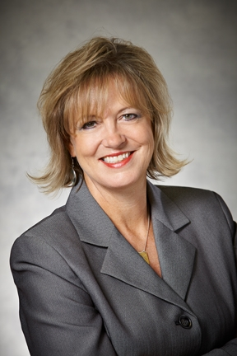
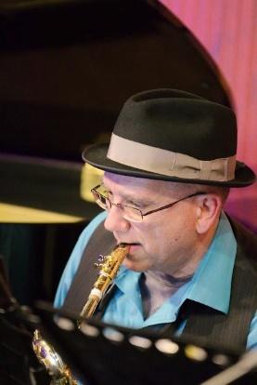
Michelle
Host & Moderator
Danny
Special Guest
Notes:
Michelle: Good Morning everyone and welcome to a Special Edition of Hot Topics!
The purpose of this hot topics is to share some relevant and honest discussion on some “hot topics in healthcare” from a real time patient and clinician, Danny Van Leeuwen. (Welcome Danny – Danny Thank-you) ☺
If you remember a few things from this mornings session
Significance of transitions of care for patients
The importance of team-based care – which includes the patient and family!
The evolving world of research and evidence-based care
The agenda of our presentation this morning is my introduction of Danny. Danny will share with us his experiences as a patient, care giver, clinician and contributor to the healthcare community in an interview format. We will leave 20 min for Q & A.

Slide 3

Welcome to our House of Elsevier Clinical Solutions
Learning and Competency Management
Reference and Decision Support
Clinical Practice
Clinical Reference
Drug Information Reference
Diagnostic Decision Support for Radiologists and Pathologists
Care Planning
Order Sets
Clinical Decision Support and Analytics
Drug Product Pricing and Clinical Database
Clinical Skills
Clinical eLearning
Home Health Care
Coding and Reimbursement Online Education
Academic Education and Certification
Patient Engagement
Professional Practice Services
Interactive Patient Education
Health Library
Data Collection by Tonic
VUCA Patient Medication Videos
Care Planning Adoption
Practice Advancement
Top-of-License Practice
Professional Development Tools
Interactive Student and Faculty Resources
Review and Test Prep Resources
Digital Books and Journals
Notes:
Michelle: Well Danny, first let me welcome you to the House of Elsevier Clinical Solutions. The audience of today’s special edition of Hot Topics are the many talented and smart individuals that work behind the scenes in multiple ways to support the various products and services we bring to the point of need for clinicians, students and patients.

Slide 4
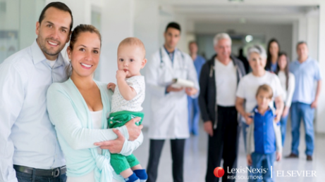
Improved Patient Outcomes
Instill the voice of the patient into the culture of Elsevier Clinical Solutions
Notes:
Michelle: At the end of the day, our focus is on improving patient outcomes.
To accomplish that we know it is also important to instill the voice of the patient in all that we do at Elsevier Clinical Solutions.
Which is how you got to us today!

Slide 5
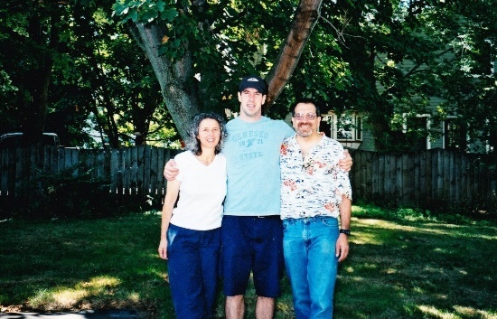
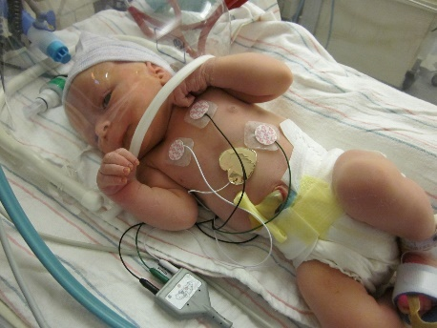
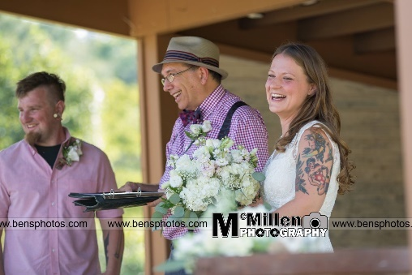
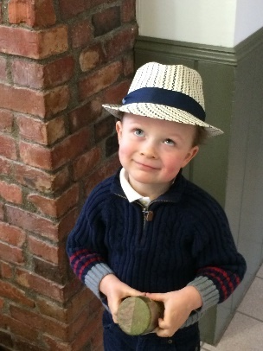
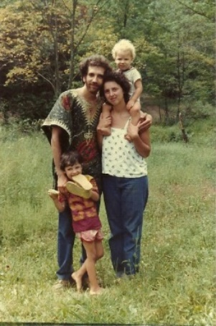
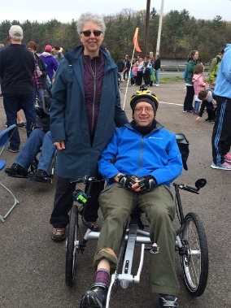
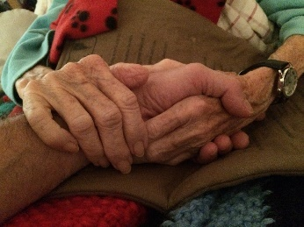
Patient, caregiver, nurse, informaticist, leader
Back-to-the-land hippie, saxophonist, minister, Opa
Nurse in home care, ED, med surg, physical rehab
ICU Manager
Director/VP QI in Managed Care, consulting, rural and urban health systems, behavioral and community health
Informaticist – EMR implementation, HIMSS, Blues Button Plus, OpenID HEART, Shark Tank Panelist
Research – co-chair PCORI’s Communication and Dissemination Advisory Panel, reviewer
Communities - Society of Participatory Medicine, PCORI, AHRQ, PCORCDS LN, Beryl Institute, MassHealth, American Academy of Communication in Health Care
Consultant, leadership coach, blogger
Empowering people as they travel together toward best health
Notes:
Michelle: So Danny, I have so enjoyed getting to know you and the many hats you where in healthcare. Please introduce yourself to my Elsevier Clinical Solution Colleagues!
Danny:
Many hats ☺ - highlights a few
Storyteller (as you will hear)
Integrated – it is a gift because “I can wear them all at once”

Slide 6
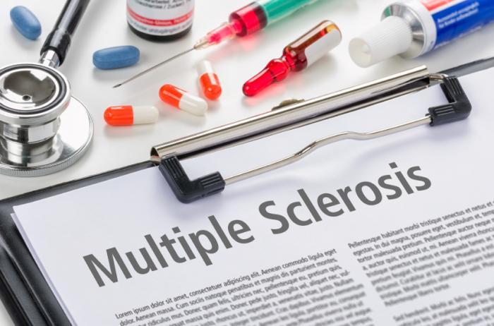
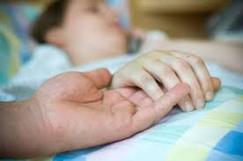
My Patient and Care Partner Hats
“Things which matter most must never be at the mercy of things which matter least”
~Goethe
Empowering people as they travel together toward best health
Notes:
Michelle – Danny, let’s start with your hats as patient and care partner
Multiple sclerosis is an autonomic immune disease that destroys the myelin sheath (coating of nerve cells). You can have de-myelinated cells in the brain, spinal cord, or optic nerves. I have it on all 3. Seriously annoying. Affects my strength, my breathing, my balance, dexterity, vision and other things I’d rather not share. But I’m very lucky that I’m pathologically optimistic, have a great family, and my mind is sharp.
I was primary caregiver for grandmother, mother, and son during end-of-life journey. All very different.
Grandmother – 80, clinically depressed with Holocaust Survivor PTSD. She wanted us to end her life. Instead we brought her to live with us in a safe place. She was pretty unhappy. We provided 24/7 care
Mother - 87 pancreatic cancer. I’ve had a good life. Wanted no tx, stay home. I’ve had enough. Lived on opposite coast. Family rotated traveling to her. Hired 24/7 care. Stopped eating and drinking.
Son – 26 melanoma – wasn’t born with a tattoo telling me how long I had to live. Whole family took care of him.
Michelle: What a beautiful example of evidence-based practice! Best research, clinical expertise and patient value/goals. (tie to Danny’s story)

Slide 7


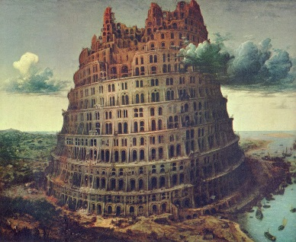
My Clinician Hats
To understand and support each other
To achieve the best outcomes
To communicate effectively during transitions
To learn and share what works
Team-Based Care
Transitions of Care
Front Line Supervisors
Health and Life Literacy
www.health-hats.com
Empowering people as they travel together toward best health
Notes:
Team based care: To understand and support each other
To achieve the best outcomes
Team-Based Care – who is the team? Patients, caregivers, care partners, clinicians, direct care staff, support staff. Last week I needed a brain MRI. It could cost me $50 or $500 out-of-pocket depending on where I got it. After 8 calls and 10 emails I still couldn’t get an appointment at the cheaper place. When I spoke with the support person at the doctor’s office, she said, what a mess – let me try to solve this today and get back to you. 2 hours she called and had it all arranged. She is definitely on my team. I have neuropathy – uncomfortable zaps down my limbs. Doctor wants to give me Neurontin. It would dull my brain. Instead I use acupuncture, massage and meditation. I can live with it without Neurontin. Unfortunately, I’m the connector between members of my team. They couldn’t imagine talking to each other.
To communicate effectively during transitions
Never-ending transitions – internal and external to any setting. Communication is tough in the best of circumstances – Paneling story
To learn and share what works

Slide 8

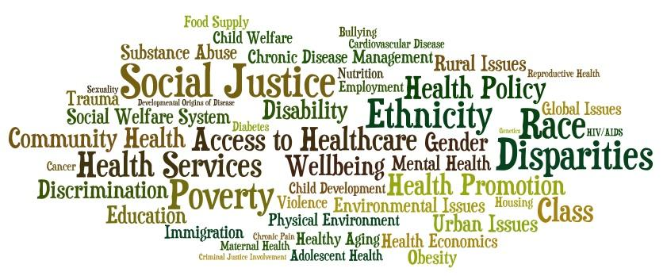
My Informatics Hats
Workflow and Lifeflow
Communities get together to solve a problem, technology helps to scale the solutions
What comes first?……Both to address the complexity of workflow and lifeflow
www.health-hats.com
Empowering people as they travel together toward best health
Notes:
Michelle: So now tell us about your key perspectives as a clinician
Work with startups who have an idea about an app and then wonder how they can engage patients to use the app. Or a portal for that matter. Frustrated with a MU goal of 10% using the portal.
Best technology is when a community, a group of clinicians, or a group of caregivers collaborate to solve a problem, then use technology to scale the solution.
A FL town had the highest rate of bicycle/pedestrian accidents in the nation. Community groups got together to identify the hot spots, the traffic flow challenges. Then a tech company built a portal video surveillance system with an analytic software to crunch the traffic data. Or a group of parents with children on the autism spectrum aging out of the support systems wanted to identify their children’s strengths and build on those strength. They support 350 families in their community. They’ve automated the assessment algorithm and designed a series of supports to build on the learned strengths and sharing it nationally.
The challenge often with technology is that it doesn’t align with clinicians’ workflow or people’s life flow. Life flow: can I find it, can I afford it, can I remember it, can I get there. DO I have the time to learn and use it.
Michelle – shares interprofessional survey results (50% knowledgeable- connect)

Slide 9
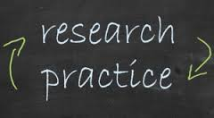
My Mantra:
Communication, Dissemination, and Implementation of Research
Just ink on paper?
Uncertainty?
What doesn’t work?
Beyond medical
Empowering people as they travel together toward best health
Notes:
Evidence is part of learning what works for populations. Evidence needs to be available to people and their teams at the point of decision. It’s a different challenge when a clinician is present and when a clinician isn’t present. People make many health decisions without a medical expert. It’s only ink on paper if the word doesn’t get out.
Social networks, Place of worship, Water cooler, Dinner table
The challenge: evidence is about % and populations. The best evidence is still uncertain. How do we communicate that?
I learn more from what doesn’t work, than what does. Just ask my wife. How do we communicate evidence that didn’t prove our point. As an editor of the JHQ, we tried for 15 years to find a submission that didn’t prove something. Completely unsuccessful.
Only now with PCORI and AHRQ, are studies being funded with non-medical interventions. E.g. mindful meditation for reducing opioid use for chronic non-cancer pain.
Milken Institute Patient-Perspective Value Framework
What are the outcomes when health decisions are made, with or without decisions aids or clinical practice guidelines
PCORI
AHRQ PCORCDS-LN

Slide 10
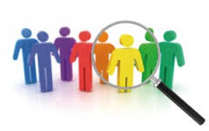
Informatics & Data: Health as an Experiment of ONE
Give me my DAMN data
What data?
Person-centered care planning
Informed decision making
ONE among many
Empowering people as they travel together toward best health
Notes:
When I interviewed my current neurologist to vet him for my team, he said I know about treatments and drugs for populations, and I know nothing about you. My job is to learn about you. You are an experiment of one.
Many patient advocates say give me my damn data. I believe that people own the data about themselves. But what data? I know as a clinician that health data is drinking dirty water from a firehose. As a patient, what data do I want? Mostly I want my health data to include my health goals – progress as slowly as possible, taking nothing to interfere with my pathological optimism. Then I want to know who is going to what, when. Did it work? In real time. I want that to be communicated whenever there is a new team member or new setting. Outcomes – falling, playing the sax
ONE among many – So if people make decisions about their health, why don’t we track the effect of outcomes of those decisions so we better understand the impact of those decisions. Cycle of decision making
Communities
Professionals
Lay people
Michelle: I noticed you use the word “informed” decision making – people also refer for the need for “shared” decision-making? Are they the same to you – and if not, how are they different?

Slide 11





My Community Hats
www.health-hats.com
Empowering people as they travel together toward best health
Notes:
Michelle: Danny, I am so impressed with your engagement in various venues to bring the voice of the clinician and patient. Share with us some of your current work that you are doing in the healthcare community.
I’m an extrovert and a joiner. I participate in many communities representing the voice of patients, caregivers, clinicians. Even if you are an introvert, I encourage you to become active in at least one community group: place of worship, club, neighborhood, association… Opportunity to hear what matters to people outside of your work life and better link your professional passion and personal values to community

Slide 12
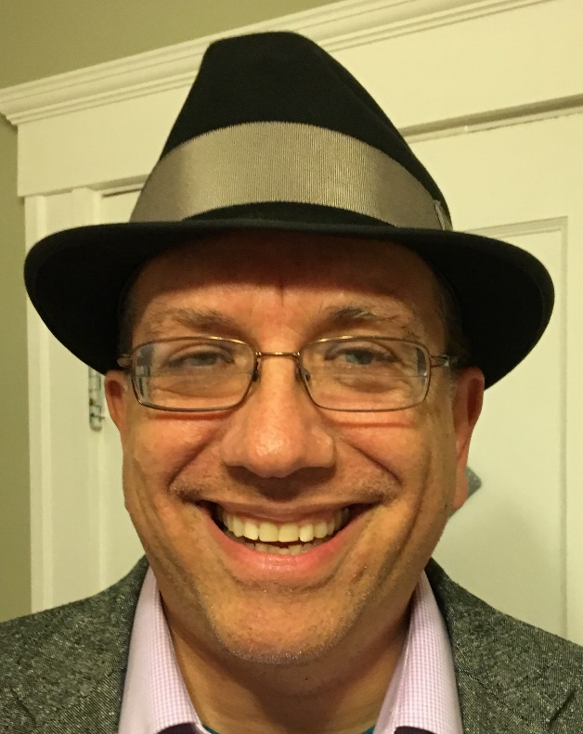
Thank-You!
Q&A
Reminder hit *6 to unmute
Then re-mute after done by hitting
*6 or your mute button
danny@health-hats.com
Blog: www.health-hats.com
Twitter:@HealthHats
danny@health-hats.com
Danny van Leeuwen, RN, MPH, CPHQ
www.health-hats.com
Empowering people as they travel together toward best health
Notes:
Thanks to Pat Rioux for building the bridge for me to Michelle and Elsevier!
In summary: three main points
Health is a team sport – everyone has value and a role
I focus on transitions – the risks and opportunities are in the cracks between team members
Evidence – what works – is a moving target – evolving, changing. Change is tough
Michelle – thank-you so much for sharing with us on this Special Edition of Hot Topics. I want to give a special shout out to the CR&W Council who worked on finding ways to engage with patients and learn what matters most.
And now I will open it up for Q &A (time check) – reminder that you must hit *6 to unmute.

